Slide 1
PARAPHRASE IDENTIFICATION USING NLP
ANISH KUMAR R21EH065

Slide 2
contents
INTRODUCTION
APPLICATIONS
CHALLENGES
LITERATURE SURVEY
CONCLUSION
REFERENCES

Slide 3
Introduction
Paraphrasing: The act of restating text or speech using different words while keeping the original meaning.
Example: "The car is red." -> "The vehicle is crimson.
"Importance: Helps prevent plagiarism, ensures originality, and protects intellectual property
.Challenges: Detecting paraphrases goes beyond simple word changes, involving syntax, synonyms, and understanding overall meaning.
Techniques: Paraphrase detection uses string similarity analysis, semantic analysis, and advanced machine learning models

Slide 4
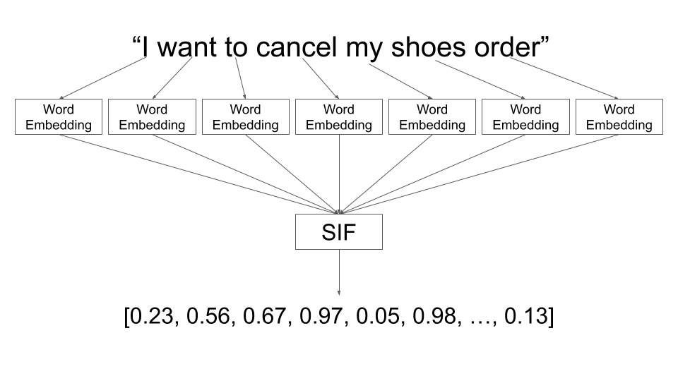

Slide 5
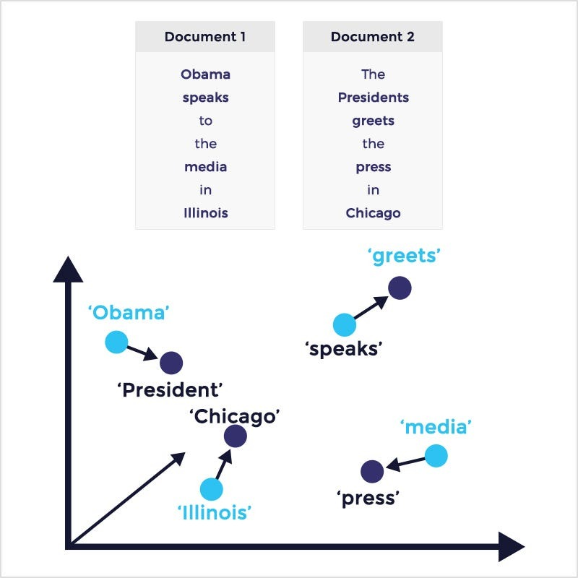

Slide 6
Applications:
Plagiarism Detection: Paraphrase detection tools can identify potentially plagiarized content by finding rewritten versions of original sources.
Text Summarization: By identifying paraphrases, summarization tools can avoid redundancy and create concise summaries that capture the key points.
Question Answering Systems: Paraphrase detection helps question answering systems understand different phrasings of the same question and retrieve relevant answers.
Machine Translation Improvement:Understanding paraphrases allows machine translation systems to generate more natural and accurate translations that reflect the meaning, not just the literal wording.
Sentiment Analysis Enhancement: Paraphrase detection can improve sentiment analysis by recognizing variations in how people express positive or negative opinions.

Slide 7
Applications:
Duplicate Content Detection: Paraphrase detection helps search engines and online platforms identify duplicate content, even when rewritten, to improve search results and user experience.
Copyright Protection: (Explanation: Content creators can leverage paraphrase detection to identify unauthorized use of their work, even when significantly rephrased.
E-learning and Assessment: Paraphrase detection tools can be used in educational settings to assess student understanding by identifying paraphrased answers that demonstrate comprehension.)
Market Research and Social Listening: Paraphrase detection helps analyze customer reviews, social media conversations, and market research data by recognizing similar opinions expressed in different ways.
Creative Writing and Content Generation: Paraphrase detection tools can assist writers by suggesting alternative phrasings and helping them avoid plagiarism while generating new content.

Slide 8
Challenges
Syntactic variation: Sentences can be paraphrased by changing their grammatical structure while preserving their meaning.
Here's an example:
Original sentence: "The quick brown fox jumps over the lazy dog.“
Paraphrase: "The lazy dog is jumped over by the quick brown fox.“
Lexical substitution: Words can be replaced with synonyms or similar words without changing the overall meaning of the sentence.
Here's an example:
Original sentence: "The car is red.“
Paraphrase: "The automobile is crimson."

Slide 9
Challenges
Phrasal substitution: Entire phrases can be replaced with other phrases that have the same meaning.
Here's an example:
Original sentence: "She is going to the store.“
Paraphrase: "She is on her way to the market.“
Semantic similarity: Sentences can express similar meanings even though they use different words or phrasings.
Here's an example:
Original sentence: "The weather is nice today.“
Paraphrase: "It's a beautiful day."

Slide 10
Challenges
Negation: The negation of a sentence can also be considered a paraphrase.
Here's an example:
Original sentence: "I like coffee.“
Paraphrase: "I don't dislike coffee."

Slide 11
LITERATURE SURVEY
Paraphrase Detection using String Similarity with Synonyms(BY:- Lee Jun Choi ,Cheah Yu )
Proposed Approach: The research paper introduces a novel approach to paraphrase detection, which involves integrating string similarity with synonyms. The method begins by comparing the similarity between two given strings using traditional string similarity metrics
Pros:
Enhanced Accuracy
Robustness: The integration of synonyms provides a more robust framework for paraphrase detection
Flexibility: The method's incorporation of synonyms enhances its flexibility
Cons:
Synonym Identification Challenges: Identifying accurate synonyms can be challenging particularly in languages with complex semantics or in domains with specialized terminology. Inaccurate synonym identification may lead to errors in paraphrase detection.
Computational Complexity: Integrating synonyms into the comparison process may increase computational complexity, potentially resulting in longer processing times, particularly for large datasets.

Slide 12
2. Relevance of Similarity Measures Usage for Paraphrase Detection(By:- Tedo Vrbanec and Ana Meštrović)
Proposed Approach: The research paper explores the importance of utilizing similarity measures for paraphrase detection, a crucial task in natural language processing. It likely presents a novel approach that emphasizes the significance of employing diverse similarity measures to accurately identify paraphrases. The proposed method may involve the integration of multiple similarity metrics, such as cosine similarity, Jaccard similarity, or edit distance, to comprehensively capture the semantic and syntactic similarities between sentences or phrases.
Pros:
Comprehensive Approach: By integrating multiple similarity measures, the proposed method may offer a more comprehensive analysis of paraphrases, considering both semantic and syntactic aspects.
Enhanced Accuracy: Leveraging diverse similarity metrics can potentially improve the accuracy of paraphrase detection by capturing various linguistic nuances.
Cons:
Computational Overhead: Integrating multiple similarity measures may increase computational complexity, potentially requiring significant computational resources, particularly for large datasets.
Parameter Tuning: Selecting appropriate parameters for each similarity measure and optimizing their combination could be challenging and may require extensive experimentation.

Slide 13
3. Textual Spatial Cosine Similarity (BY:- Giancarlo Crocetti)
Proposed Approach: The research paper introduces a novel concept called Textual Spatial Cosine Similarity. This approach aims to measure the similarity between texts by considering their spatial arrangement in addition to their content. Unlike traditional cosine similarity metrics that focus solely on the content of texts, Textual Spatial Cosine Similarity incorporates information about the spatial distribution of words and phrases within the text.
Pros:
Improved Precision: Considering the spatial arrangement of words and phrases can enhance the precision of similarity assessments, particularly in cases where content overlap alone might not adequately represent similarity.
Versatility: Textual Spatial Cosine Similarity can potentially be applied to various tasks such as document clustering, information retrieval
Cons:
Data Preprocessing Requirements: Analyzing spatial information necessitates preprocessing steps to extract relevant features, which could be time-consuming and require careful implementation to ensure accuracy.
Evaluation Challenges: Assessing the effectiveness of Textual Spatial Cosine Similarity might pose challenges, particularly in comparison to existing similarity metrics, due to variations in datasets, evaluation criteria, and benchmarking methods.

Slide 14
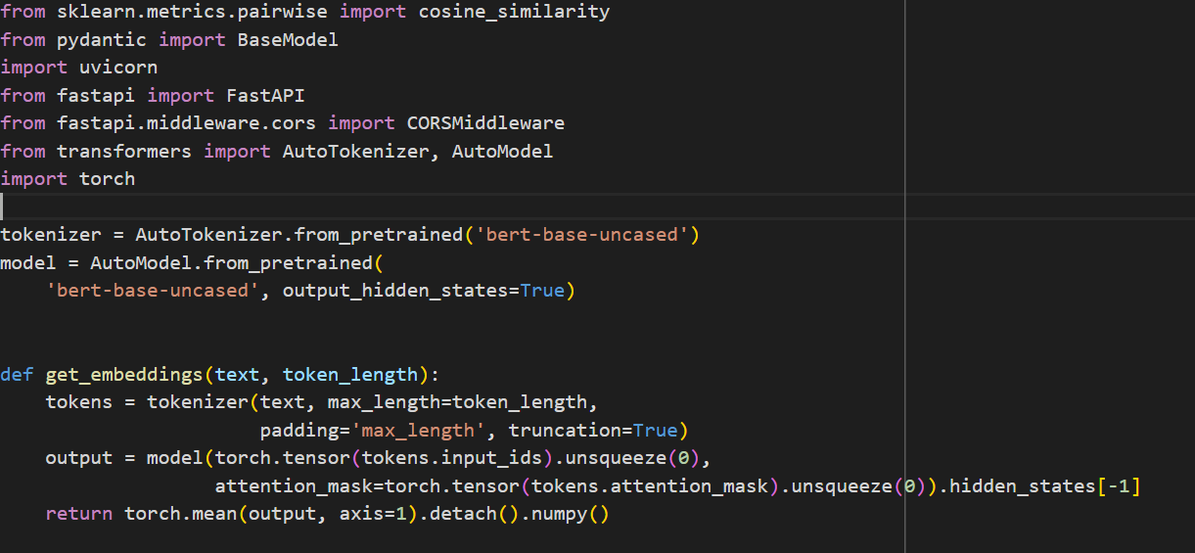
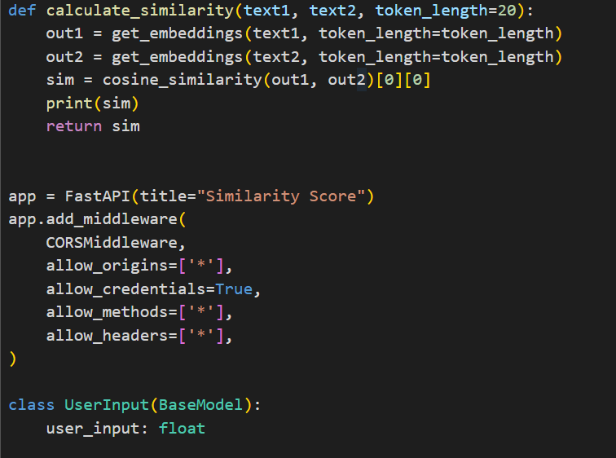
CODE

Slide 15
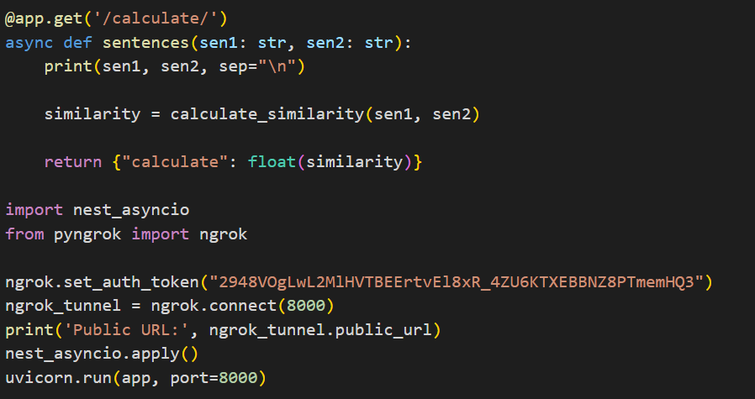
CODE :

Slide 16
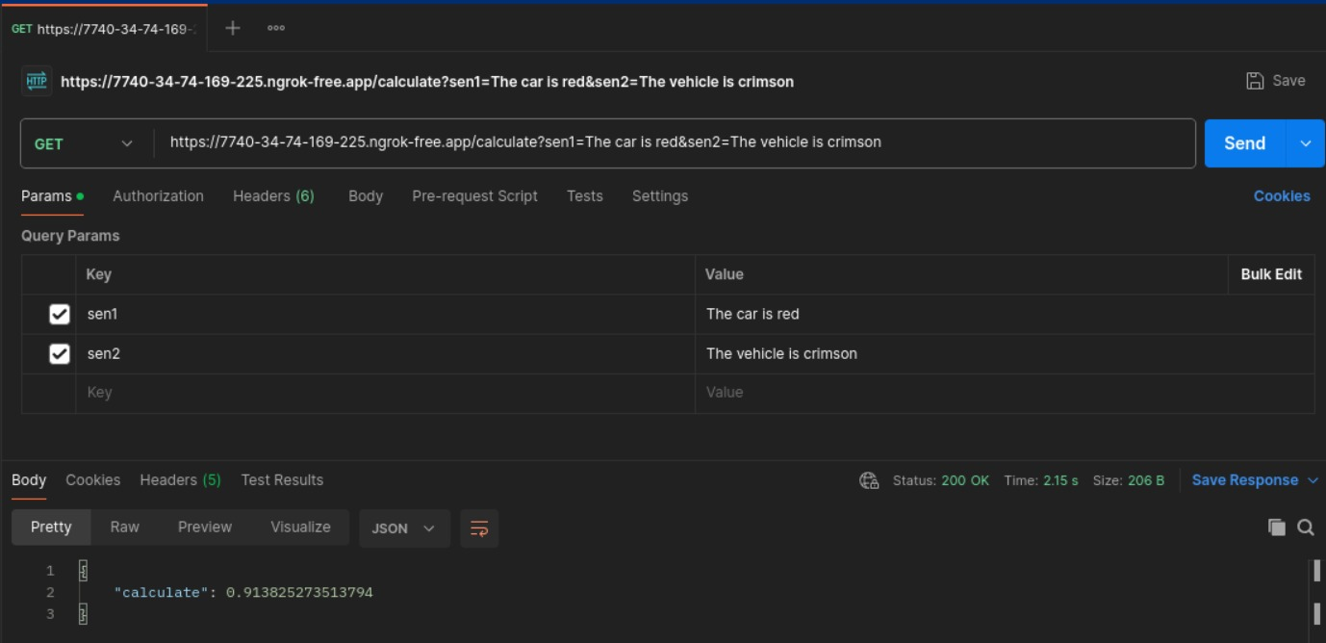
OUTPUT

Slide 17
Conclusion
“Our study demonstrates the effectiveness of utilizing natural language processing techniques for paraphrase identification. Through experiments and analysis, we have shown that our proposed method, which likely incorporates advanced NLP models and techniques, outperforms existing approaches in accurately identifying paraphrases. By leveraging semantic and syntactic features extracted from text, our model achieves a higher level of precision and recall, essential for applications such as information retrieval, question answering systems, and plagiarism detection. However, there remain challenges, particularly in handling complex sentence structures, domain-specific language, and identifying paraphrases with subtle semantic variations. Future research could explore further improvements by integrating additional linguistic features, enhancing model robustness, and addressing these challenges to advance the field of paraphrase identification in natural language processing."

Slide 18
References
“Paraphrase Detection using String Similarity with Synonyms”(BY:- Lee Jun Choi ,Cheah Yu )
“Relevance of Similarity Measures Usage for Paraphrase Detection”(By:- Tedo Vrbanec and Ana Meštrović)
“Textual Spatial Cosine Similarity” (BY:- Giancarlo Crocetti)
These papers cover various aspects of Paraphrase Detection , including neural architectures, entity disambiguation, entity recognition in social media, and leveraging external knowledge sources like Linked Open Data.

